Slide 1



Slide 2


Slide 3
Content
Operating principles of fuses
Inverse time/current characteristic of fuses
Fuses used as fault current limiters
Fuses and fault loop impedance
Fuse selection

Slide 4
Circuit Protection
What is it’s Job?
Protect circuit wiring against overheating & deterioration due to overloads
Quickly interrupt a short circuit so:
Limit the energy let through
Reduce the touch potentials rising too high

Slide 5
Circuit Protection
Fuses
Circuit breakers
Next lesson

Slide 6
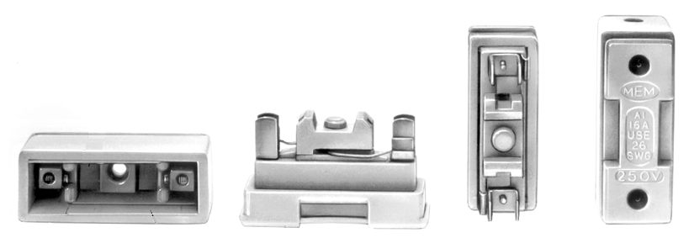
Fuses
Two Basic types
Rewireable

Slide 7
Fuses
Two Basic types
Rewireable
Sealed
Gas filled
Silica filled
Glass automotive fuses
HRC

Slide 8
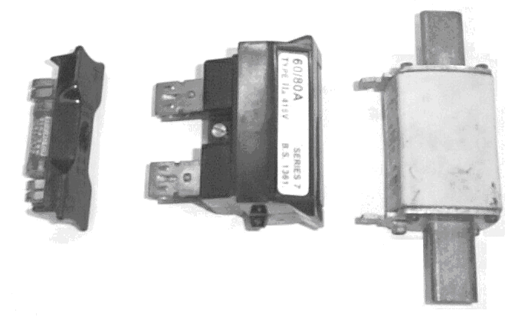
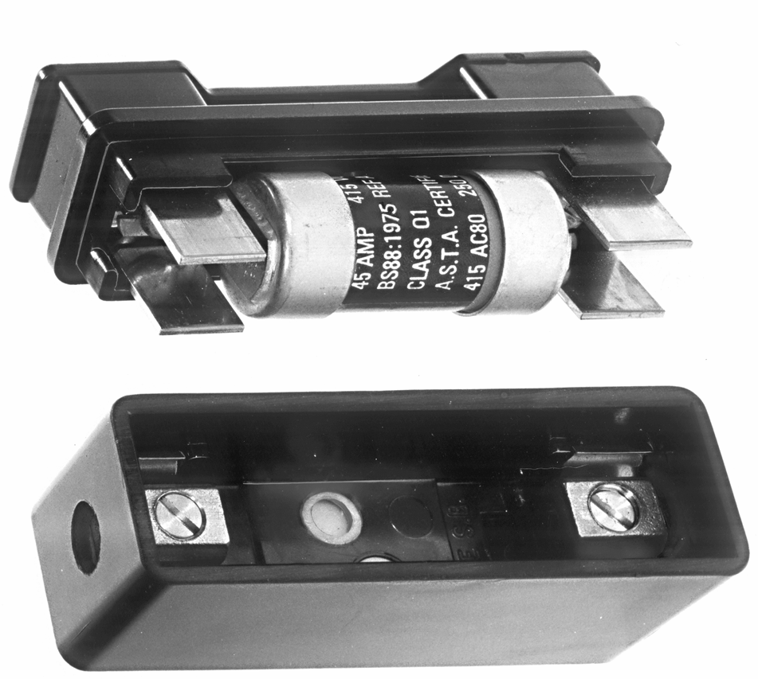
HRC Fuses
(High Rupture Capacity)

Slide 9
Fuses
Two Basic types
Still provides the greatest fault handling capacity for the size
Rewireable
Sealed
Gas filled
Silica filled
Glass automotive fuses
HRC

Slide 10
How Does A Fuse Work?
As current increases, fuse element heats up
Becomes liquid, and falls away.
An arc forms between the ends.
The ends melt away, the arc becomes longer.
Eventually the gap is so great that it is too long for the arc. Current stops flowing
H = I²t

Slide 11
Definitions
The maximum current that a fuse can carry continuously without deterioration
Current Rating
Voltage Rating
Time-Current characteristics
The maximum voltage that the fuse can safely operate.

Slide 12
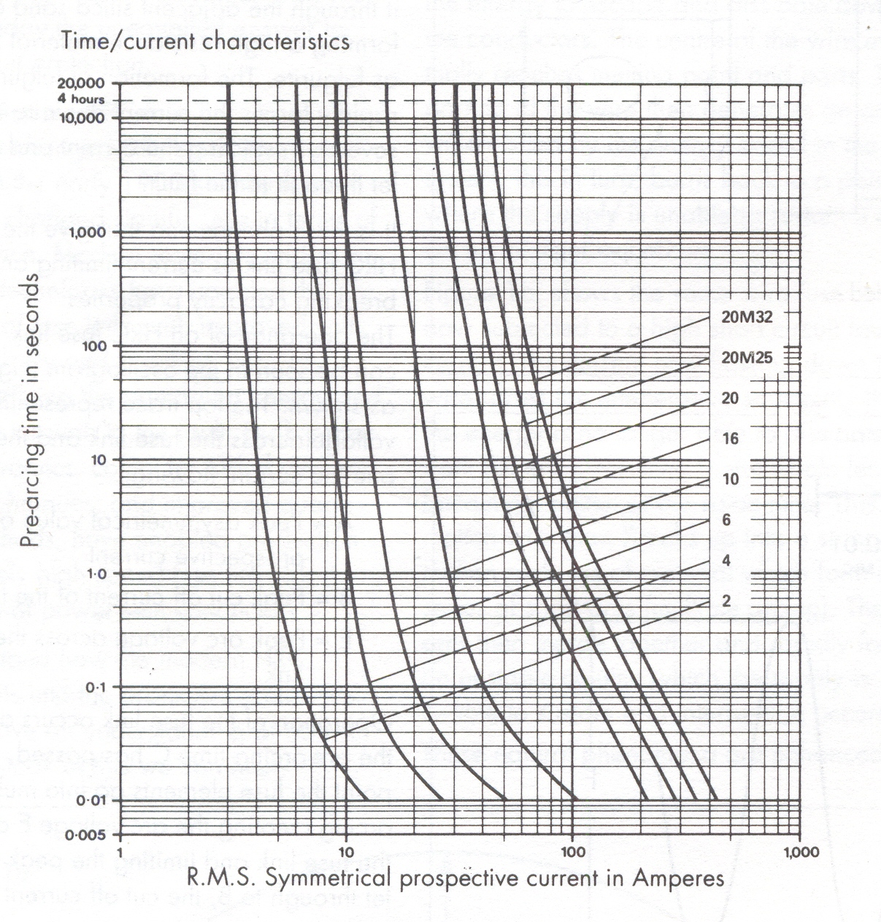
Time-Current characteristics
Logarithmic Scale
100 Sec
10 Amp Fuse
Trip time
0.6 Sec
0.1 Sec
20A
Current
30A
40A

Slide 13
Time-Current characteristics
CABLE
Insulation
Damage to
CABLE
Insulation

Slide 14


✓

Slide 15
Definitions
Current Rating
Voltage Rating
Time-Current characteristics
Pre-arcing time

Slide 16
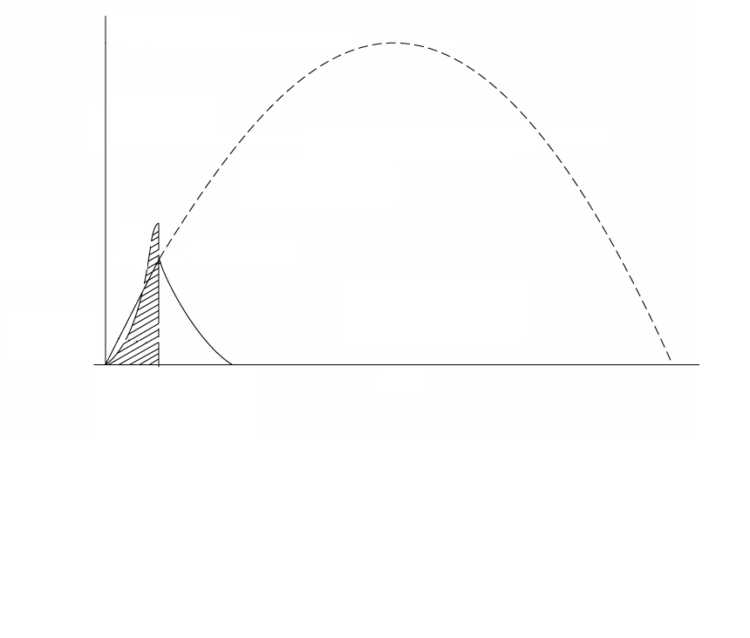
Peak Prospective Current
RMS Prospective Current
Current that fuse blows

Slide 17
Current that fuse blows
Pre-arcing time

Slide 18
Definitions
Current Rating
Voltage Rating
Time-Current characteristics
Pre-arcing time
Arcing time

Slide 19
Current that fuse blows
Arcing time

Slide 20
Definitions
Current Rating
Voltage Rating
Time-Current characteristics
Pre-arcing time
Arcing time
Minimum fusing current

Slide 21
The minimum current that the fuse element will start to melt
Minimum fusing current

Slide 22
Definitions
Current Rating
Voltage Rating
Time-Current characteristics
Pre-arcing time
Arcing time
Minimum fusing current
Fusing Factor
=
Min fusing current
Current rating
Typical values are in the order of 1.5 to 2

Slide 23
Definitions
Current Rating
Voltage Rating
Time-Current characteristics
Pre-arcing time
Arcing time
Minimum fusing current
Fusing Factor
Total operating time

Slide 24
Current that fuse blows
Total operating time

Slide 25
Definitions
Current Rating
Voltage Rating
Time-Current characteristics
Pre-arcing time
Arcing time
Minimum fusing current
Fusing Factor
Total operating time
Cut-off current

Slide 26
I² t
Shaded area =
OR
Energy let through
Current that fuse blows
Cut off current

Slide 27
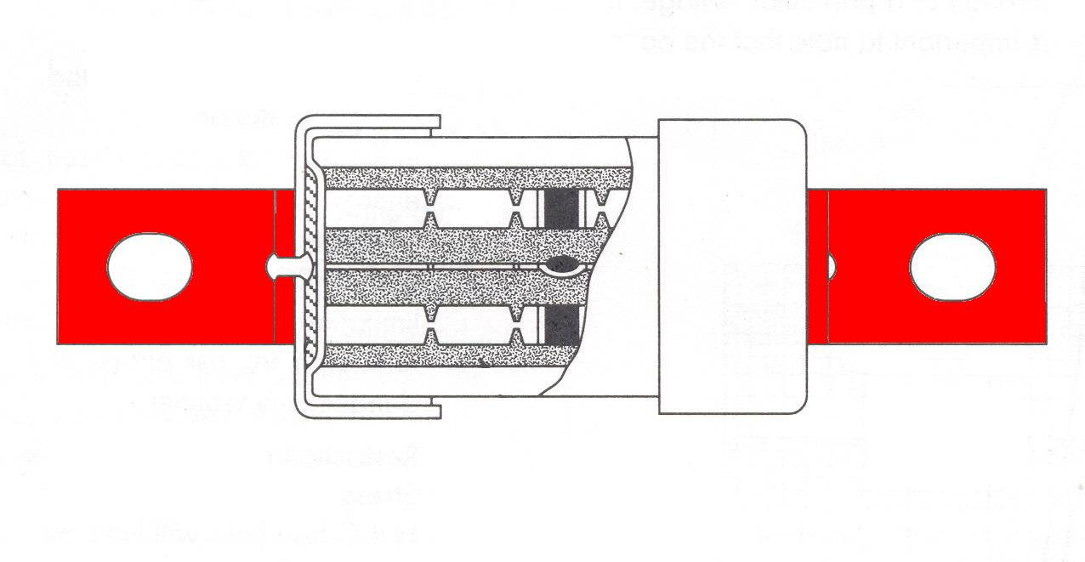
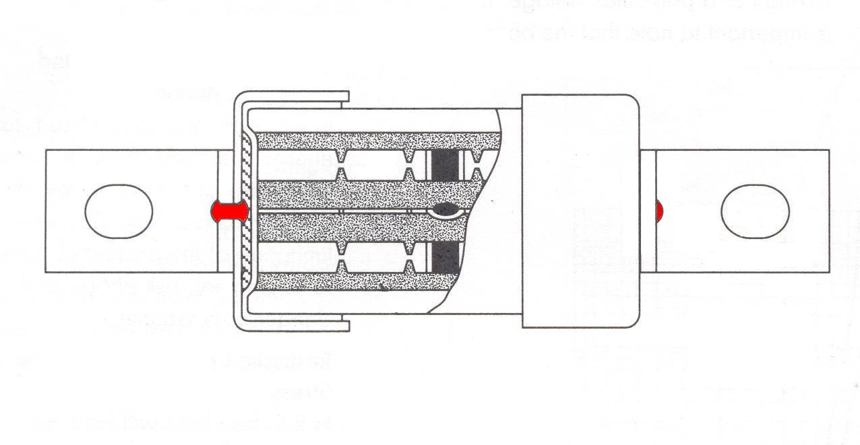
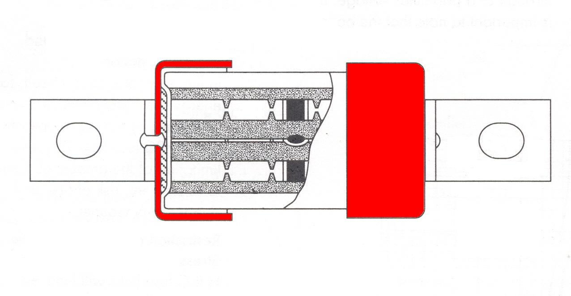
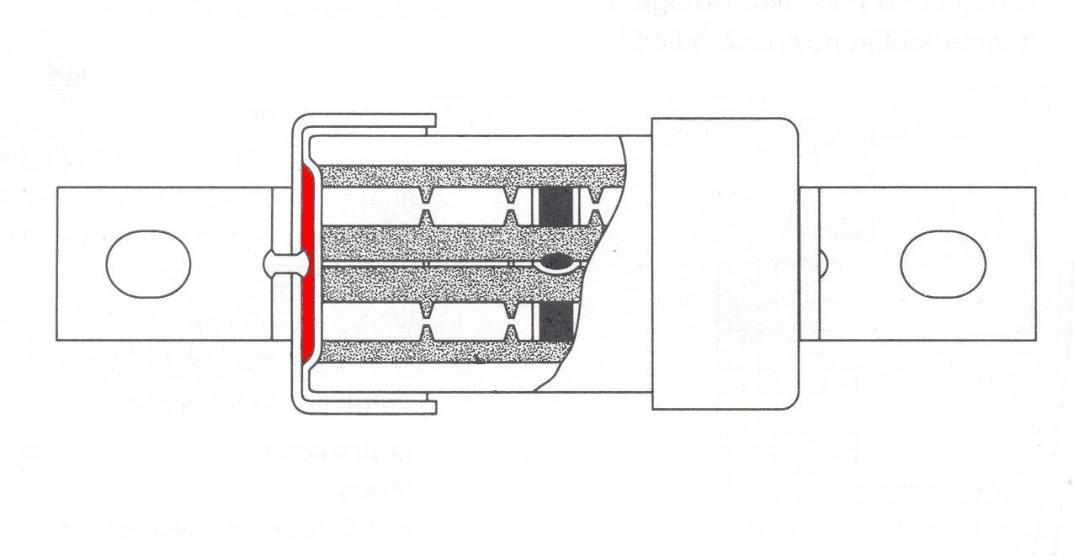
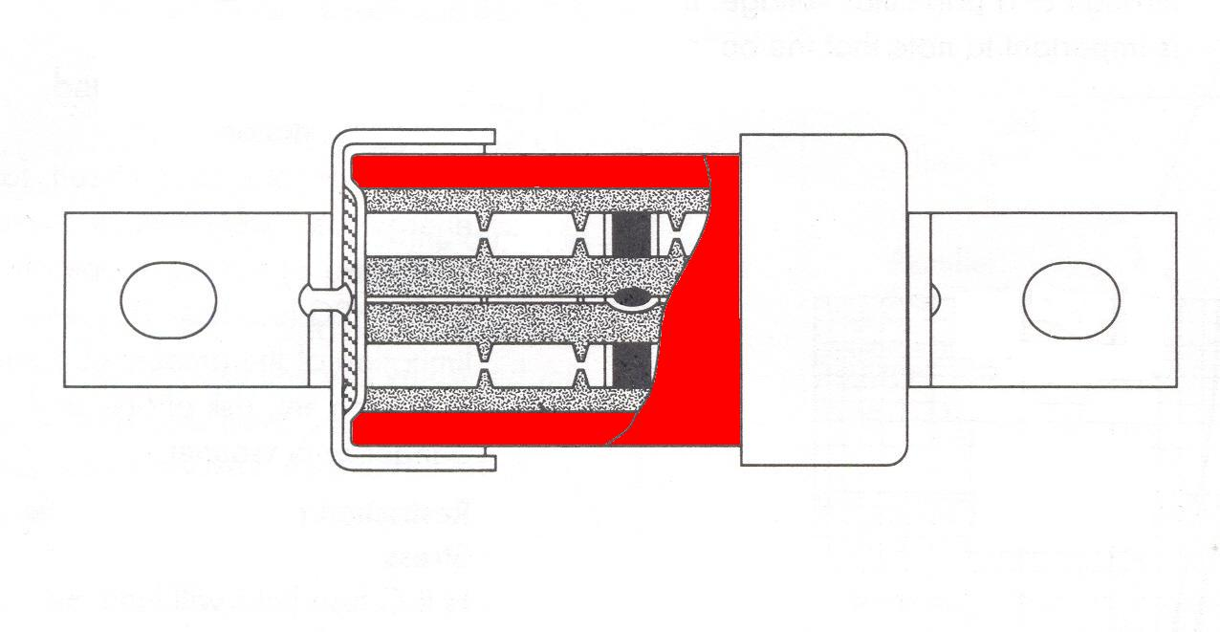
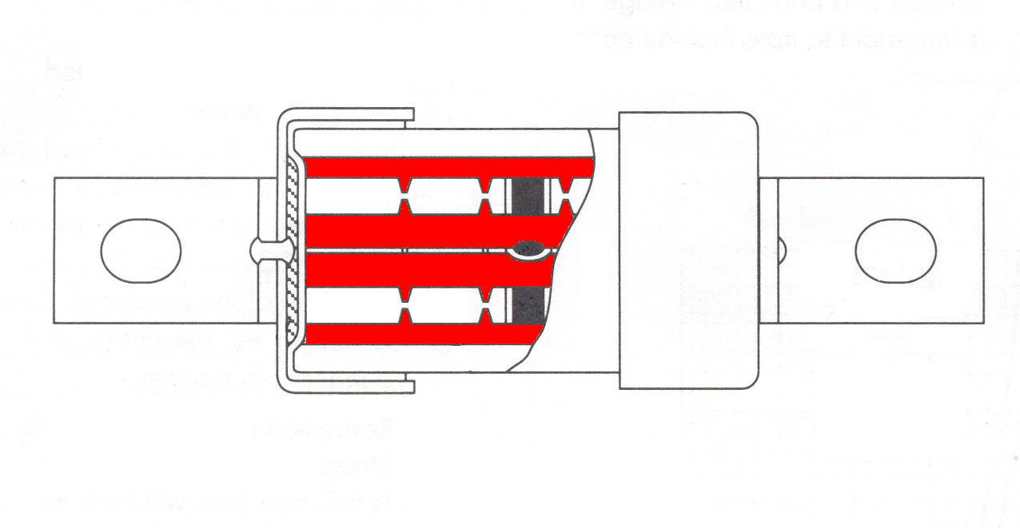
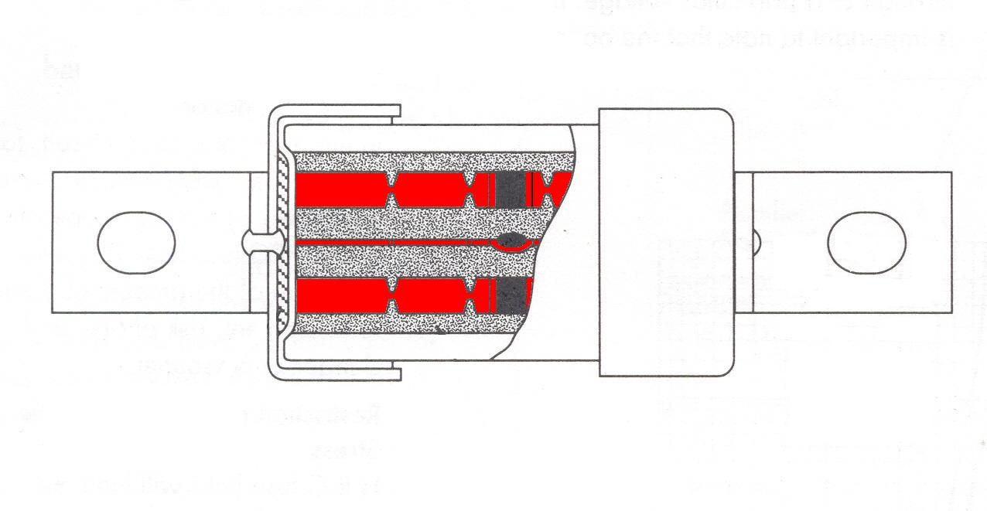
Construction
Copper Tangs
Ceramic Tube
Fuse elements
Sealing Disk
End-caps
Graded Sand
Tangs Riveted & Soldered to end-caps

Slide 28
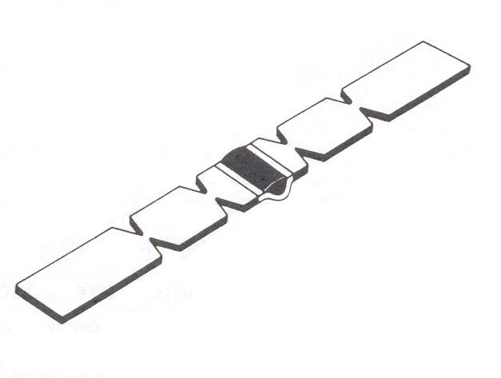
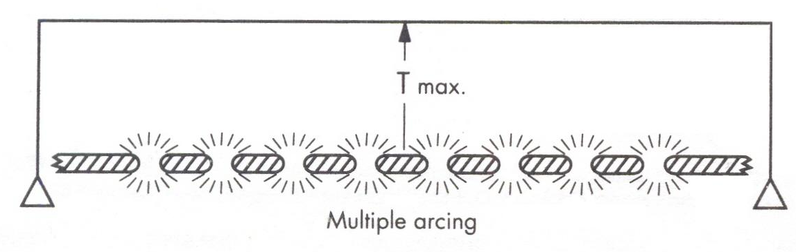
With multiple arc points the time to blow is faster
Standard HRC Fuse Element

Slide 29
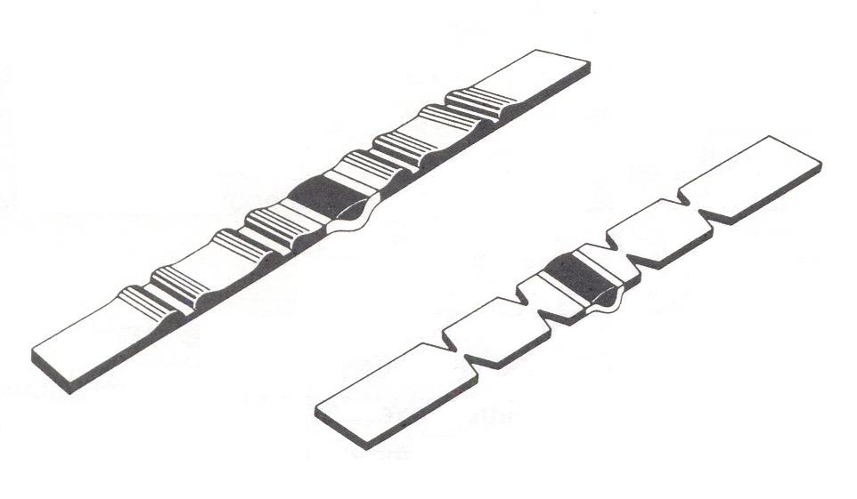
Fusible Elements
Copper sections that blow in short circuit conditions
Silver/Tin section blows in overload conditions
Silverbond Rolled Element
Standard Element

Slide 30
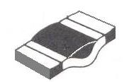
With overload currents the tin & silver combine to produce an alloy that melts at 230ºC not at Silver’s melting point of 960⁰C
Eutechnic Alloy
Tin
When heated changes from solid to liquid without going though the plastic region
Silver
Also known as the “M” effect

Slide 31
HRC HV Fuse Types
Distribution/Transformer
    Transformer inrush currents
    (high current for short period of time)
    Overload protection
    Operate in reasonable period of time with regard to secondary short circuit
  Motor circuit
    Fast operation for short circuits
    High inrush for long period of time

Slide 32
HRC Low Voltage
High breaking capacity & energy limitation.
Restriction of electro-mechanical stress on cables and busbars
Reliable short circuit and back-up protection.
Accurate discrimination.
Low over-current protection.
Non-deterioration due to no moving parts

Slide 33
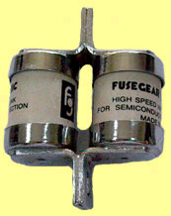
HRC Semiconductor Fuses
Electronics are more sensitive than motors or cables
Energy let through has to be a lot less.
Must be very fast & accurate in operation
Fusing elements are made of all silver, & thinner than standard

Slide 34
Matching Protection to a Cable
A cable’s current carrying capacity must be equal or larger than the load current
Circuit protection must be equal to or smaller than the cable’s current carrying capacity
AS/NZS 3000:2007
Clause 2.5.3.1
Page 76
I_{B} ≤ I_{N} ≤ I_{Z}
Load Current
≤ Protection
≤ Cable Current carrying capacity

Slide 35
20 Amps
Cable will be damaged
X
15 Amps
10 Amps
I_{Z}
I_{B}
I_{N}
Current
Rating of Protection
Maximum Current
Cable can supply
Load Current

Slide 36
20 Amps
Cable will be damaged
X
15 Amps
Protection will nuisance trip
10 Amps
I_{Z}
I_{B}
I_{N}
Current
Rating of Protection
Maximum Current
Cable can supply
Load Current

Slide 37
Matching Protection to a Cable
But the protection must match the cable
AS/NZS 3000:2007
Clause 2.5.3.1
Page 76
For circuit breakers
I₂ ≤ 1.45 ≤ I_{Z}
Tripping current for protective device
Cable current carrying capacity
Constant for circuit breakers

Slide 38
Matching Protection to a Cable
But the protection must match the cable
AS/NZS 3000:2007
Clause 2.5.3.1
Page 76
For Fuses
I₂ ≤ 1.45 ≤ I_{Z}
I₂ ≤ 1.60 ≤ I_{Z}
Tripping current for protective device
Cable current carrying capacity
Constant for fuses

Slide 39
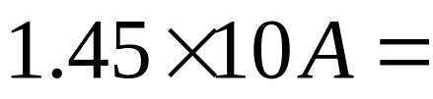
However
A cable can withstand a overload current of 1.45 x it’s rating before the insulation is damaged
14.5 Amps
14.5 Amps
10 Amps
I_{Z}
Maximum Current
Cable can supply

Slide 40
Circuit Breakers
A Circuit breaker’s trip curve is matched to a cable’s curve
Tripping current is 1.45 x rated current
14.5 Amps
10 Amps
I_{Z}
I_{N}
14.5 Amps
Current
Rating of Protection
Maximum Current
Cable can supply

Slide 41

Fuses
A Fuse’s trip curve is different to a cable’s curve
16 Amps
Tripping current is 1.6 x rated current
X
14.5 Amps
Cable will be damaged
10 Amps
I_{Z}
I_{N}
16 Amps
Current
Rating of Protection
Maximum Current
Cable can supply

Slide 42
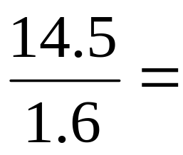
Fuses
16 Amps
14.5 Amps
1.6
10 Amps
I_{Z}
I_{N}
9 Amps
Current
Rating of Protection
Maximum Current
Cable can supply

Slide 43
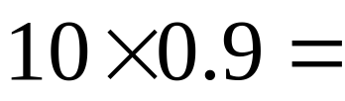
Fuses
16 Amps
14.5 Amps
10 Amps
0.9
I_{Z}
I_{N}
9 Amps
Current
Rating of Protection
Maximum Current
Cable can supply

Slide 44
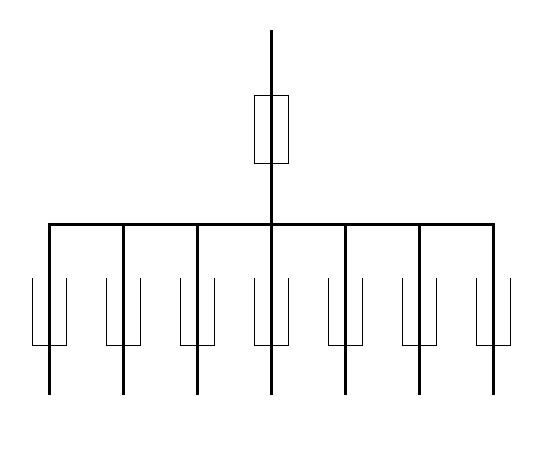
Discrimination
Poor
A fault in one circuit should not affect other circuits
AS/NZS 3000:2007
Clause 2.5.6
Page 90

Slide 45
Discrimination
A fault in one circuit should not affect other circuits

Slide 46
Discrimination
A fault in one circuit should not affect other circuits
For times greater than 0.01 seconds
F₁
F₁ = F₂ x 1.6
64A
F₂
40A
AS/NZS 3000:2007
Clause 2.5.7.2.3(b)
Page 92

Slide 47
Discrimination
A fault in one circuit should not affect other circuits
For times greater than 0.01 seconds
F₁
F₁ = F₂ x 1.6
80A
For times less than 0.01 seconds
F₁ = F₂ x 2
F₂
40A
(I²t) F₁ = (I²t) F₂ x 2
AS/NZS 3000:2007
Clause 2.5.7.2.3(b)
Page 92

Slide 48
F₁ = 2 x F₂
F₁
F₂

Slide 49
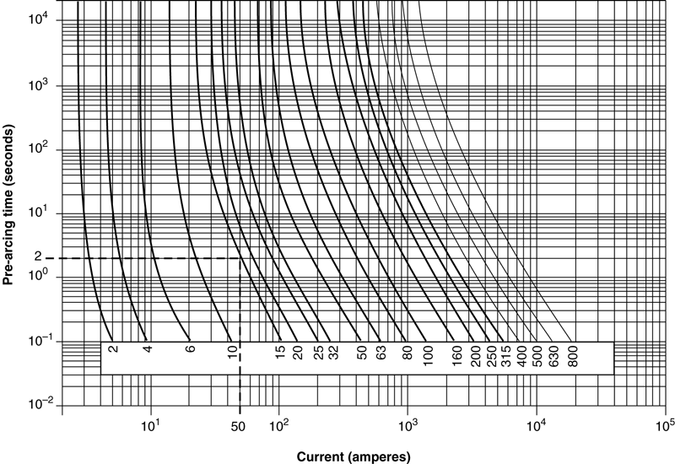
Figure 13.15(b) Time–current characteristic curves for 2 A to 800 A general fuse links

